Slide 1
Enterprise People Analytics
Foundational Concepts
Team Overview and Product Review

Slide 2
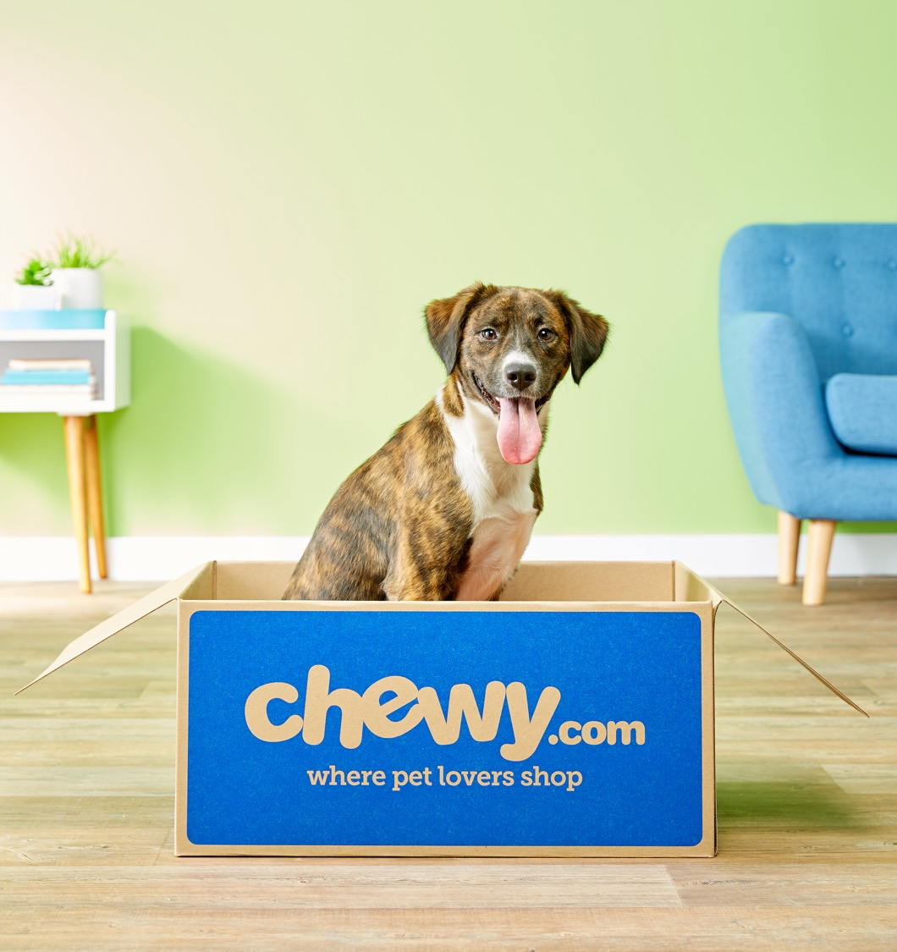
Agenda
01.
EPA Team Overview (10 mins)
02.
Data and Platform Update (15 mins)
03.
Highlighted Products (25 mins) - Enterprise HR (C-Suite Summaries, DEI)
- Talent Acquisition
- FC HR (EVP, Talent)
04.
FY22 Priorities, Wins, and Opportunities (10 mins)
2
Notes:
People Analytics set up/structure – is it working for Chewy teams – 10 mins
State of data plumbing, engineering and platforming – 10 mins
State of team / hiring – 10 mins
Top priorities – 15 mins Key Learnings Product Inventory in appendix Can we assign everyone on Kyle’s team to a client group? Where do we have potential resource gaps?

Slide 3
EPA Team Evolution
The Enterprise People Analytics team delivers analytic products, capabilities and services which ensure HR decisions are grounded in data, measure impact, and generate actionable insights that enable Chewy's HR strategy.
Establish Corporate People Analytics
P1 FY20: Hired Sr Manager, People Analytics (1 HC)
Establish Customer Service People Analytics
P10 FY20: Hired AD, People Analytics (1 HC)
Expand Corp / CS People Analytics Teams
P11 FY21: Centralized Enterprise People Analytics team supporting 12 customer groups (total 12 HC)
P5 FY22: Hired FY21 Intern to establish Data Science capability (+1 HC)
Expand EPA team
P4 FY21: 6 HC approved to support TA (CS and FC), and expand CS People Analytics Team
P6 FY22: Centralized HR BI Developers to HR from IT (+2 HC)
P12 FY22: Exit rate of 15 HC suppoting 14 customer groups
Establish Enterprise People Analytics Committee
FY21: Created a cross-functional working group to manage the funnel of analytics projects across 6 customer groups (FC, CS, and Corp HR, Corp TA, Finance, DEI)
FY21: 4 HC allocated for Corp People Analytics Team
Establish Enterprise People Analytics Team
COVID

Slide 4
EPA Operating Model
People Analytics Pillars
Data Strategy
HRBI & Tools
People Insights
People Science
(Portfolio, Lab, Research)
Define and shape overall data strategy and supporting tech
Own the HR data dictionary for data defintions / metrics
Act as primary authority on data model
Establish governing and data quality strategies
Set the vision and strategy of data products and BI tools to support the analytics, reporting, and decision support needs for HR and business teams
Deliver people analytics consulting
Drive the adoption and evolution of our people analytics products, storytelling, and external benchmarking
Responsible for portfolio planning, lab and experimentation, and data science projects aimed to uncover new insights and opportunities for HR
Data Architecture
Dashboards / Visualization
Client / Adoption Support
Experimentation /
Descriptive Statistics
Data Governance
Reporting Products (Sustainability / Reliability)
Inform and measure the
HR Strategy
Deep Analytics / Projects / Forecasting
Data Storage / Security
UX / Design
Storytelling and Insight Generation
Integrated, Data-Driven HR Insights with Adoption Measurement / Feedback Loop
Notes:
Adoption / Voice of the Customer

Slide 5
EPA Team Org Chart
Open Director,
Enterprise People Analytics
Matthias Chan AD, Data Architect
Kyle Christman Manager, People Insights
Nicole Ziliotto Manager, People Insights
Sadie Rangaraj Manager, People Insights
Michelle Morani Sr. Program Manager
David Li HRBI Developer
Keelie Williams Sr. People Insights Manager
Baron Liu Data Scientist II
Arun Chattopadhyay HRBI Developer
Daljeet Gambhir Sr. Reporting & Data Analyst
Pat Hoye HRBI Developer
Shannon DuQuesnay BI Engineer II
David Gardner* Sr. People Insights Manager
David Gardner* Sr. People Insights Manager
Lalit Pandey BI Engineer II
Chuqi Liu Data Scientist I
(Intern Conversion in FY23)
*Once Sadie transitions from FC HR to People Science, Nicole will assume ownership of FC HR and David will shift over and report directly to Nicole.

Slide 6
EPA Customer Alignment
Client Group
People Insights
(Leads)
HRBI Support
(Technical)
Decision Science / Listening Strategies
TA
FC TA
Kyle Christman
Arun / David
Sadie Rangaraj
(Baron / Chuqi)
CS TA
TA Ops
Comp
Comp
Nicole Ziliotto
(Keelie / Daljeet)
Lalit / Shannon
Finance
Talent
Talent Mgmt.
L&D
DEI
HR
Corp HR / HR Ops
CS HR / Ops
FC HR / Ops
Sadie Rangaraj
(Pat Hoye / David Gardner)
Notes:
Find a way to show the team and alignment
Centralized – pros/cons? – what’s working / what’s not working slide
Customer to product to use of data Is this working?

Slide 7
Data & Platform Update

Slide 8
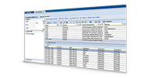



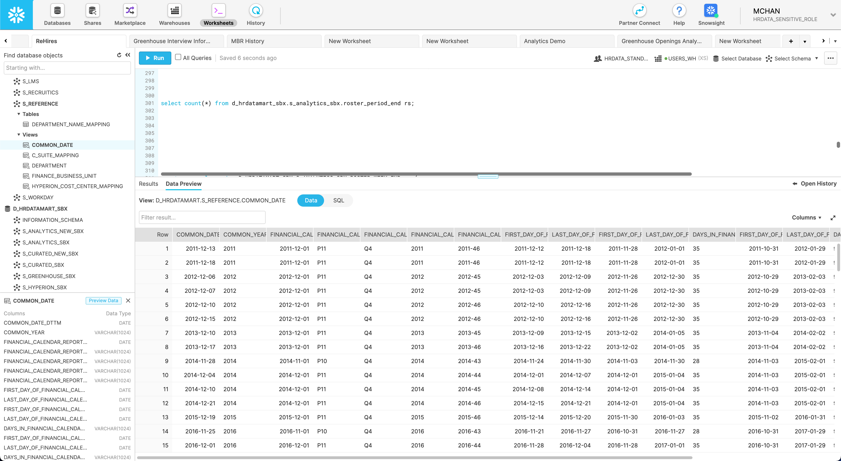






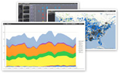














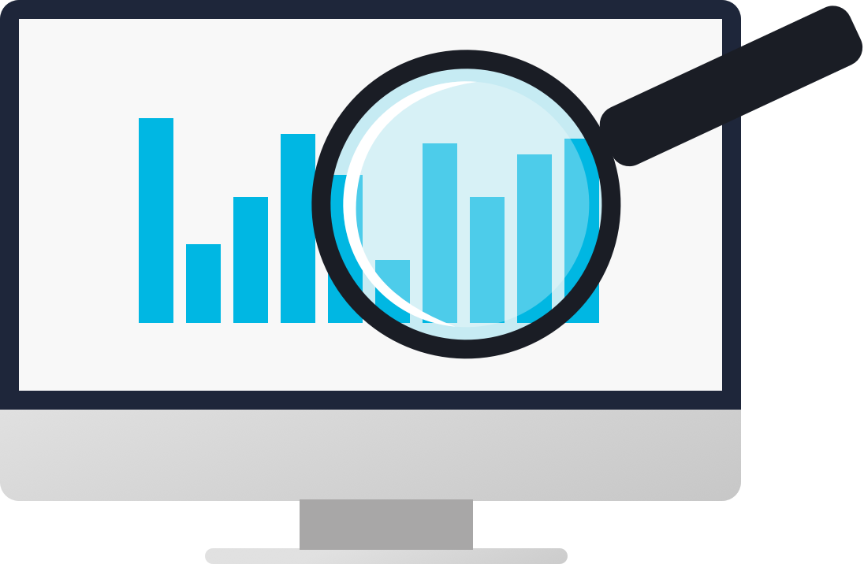

HR Data Mart Platform – Conceptual Diagram
Logical Layers (Groupings) of Structured, Queryable Data in Snowflake
User Queries
Analytics Layer
Enterprise Reporting
Data Sources
Curated Layer
Business Accessibility
Raw Layer
Storage Layer
Advanced Analytics
Central Hub for Analytics, Insights and Science
Data Quality
Reference / Master Data Management and Data Governance

Slide 9
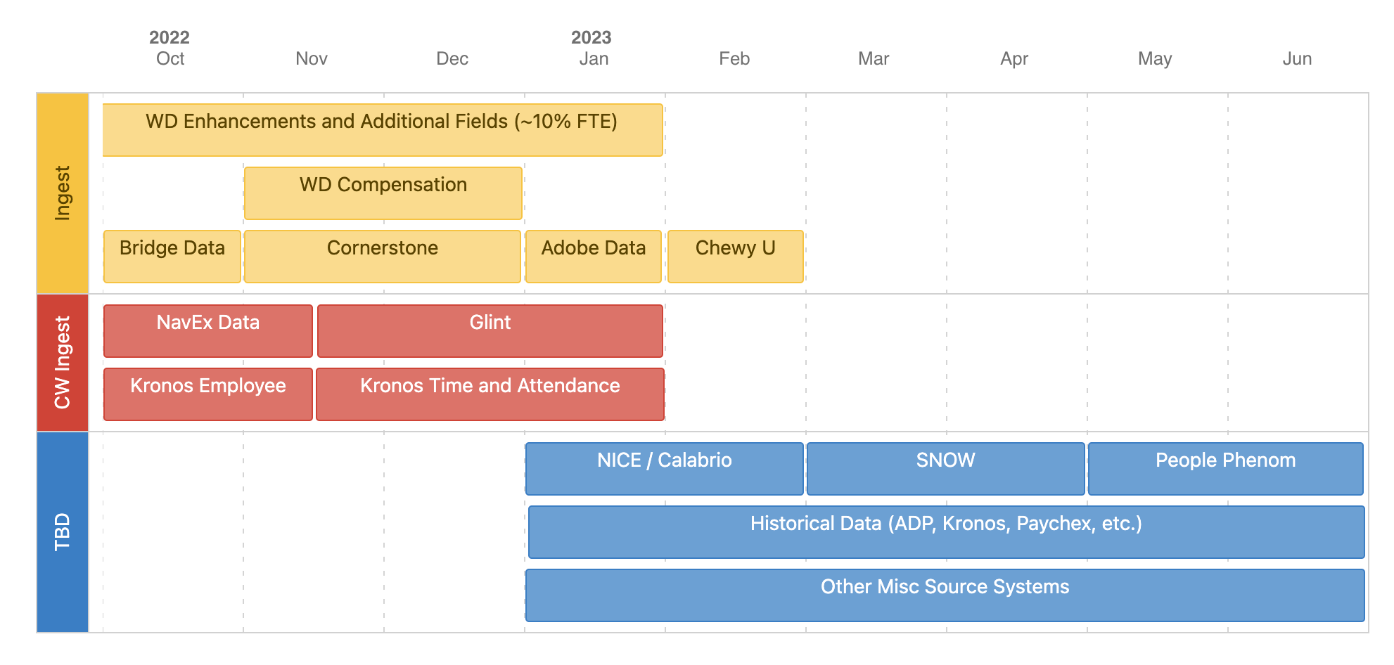
HR Data Mart Roadmap

Slide 10
EPA Data Evolution
The HR Data Competency Program will focus on delivering the Right Data to the Right People at the Right Time.
Right Data - Standardized and Reusable Definitions and Metrics
Right People - Secured, Governed and Consistent Access to HR Data
Right Time – Easy, Consistent and Timely Reporting (Operational Reporting, HR Data Mart, Visualizations, Analytics and Data Science Models)
Implementation of Workday
P7 FY20: Consolidation of source data, intended to be single source of truth for employee data
Creation of HR Data Mart
FY20: Built for individual products (Viking, Brass Tacks, Eagle Eye)
New Requests and enhancements take 1 to 6 months
Creation of Data Strategy Tower within EPA
Data Maturity Assessment completed, and gaps in consistency, scalability and foundational data identified
P12 FY21: AD, Data Architect hired
Re-evaluate the need for Separate Platforms
Privacy requirements lead HRIT and EDS team to recommend separate platform (instance) for HR Data
P4 FY22: Confirm with EDS, Snowflake and HR Data Governance team that we do indeed need to have a separate instance of Snowflake
Phase 1 of Business Layers Deployed
P8 FY22: Majority of Greenhouse and Workday data reconfigured for scalability and future development
HR Data Competency Program Created
FY22: Target first three for end of FY22 (Snowflake Technical Updates, Business Layers of Data Mart, Standard Definitions and Metrics)
Roster and Manager Hierarchy created by Period and Week

Slide 11
FY22 Priorities: Data Engineering / Re-Platform
Technical Architecture Updates
Standard Definitions and Metrics
Business Layers of the Data Mart
Confirmed with Snowflake and EDS team that HR needs to have a separate instance of Snowflake
Turned on Row and Column Level Anonymization and access governance to protect privacy and mitigate risk
Created Audit Framework to trigger alerts for Data Quality to proactively update and fix data
Enabling Okta and SSO (In Progress)
Identified 87 Key Metrics to standardize definition and build out in HR Data Mart
24 of the Key Metrics already have definitions that we just need to confirm as the standard definition and build out in HR Data Mart
Engaged HRLT to gain input into definitions
Hired Program Manager of the HR Data Competency Program in P8 to drive the standardization and governance conversations
Deployed 25 views in the Curated (Harmonized) Layer that are re-usable, system agnostic (concept based) and fully scalable for future analytics
Deployed 4 views in the Analytics Layer (Manager Hierarchy and Roster both by Period and by Week)
Foundational data model created and re-configured, so new analysis can be done in hours rather than building specific views which historically have taken months to build.

Slide 12
Data Competency – Proposed FY23 OP1
ID | Data Competency Initiative | Priority | Target Start Date | Target End Date | Additional Notes
0 | Snowflake Technical Architectural Updates | FY22 | P04-22 | P12-22 | Owned by HRIT
1 | Standard Data Definitions and Metrics | FY22 – FY23 | P04-22 | P12-22 | Paused from P06 to P08 for resourcing and Business Layer development. Phase 1 Completion by P12-22, and Phase 2 ongoing throughout FY23
2 | Curated and Business Product Layer in Snowflake | FY22 | P06-22 | P08-22 | Business Layers created and deployed in P08-22. Additional sources of data through to the Business Layers will be ongoing work.
3 | Historical (Point-in-Time) Reporting and Historically Reported Metrics | FY23 | P01-23 | P02-23
4 | HR Data Product Inventory | FY23 | P01-23 | P03-23
5 | Business Capability Model | FY23 | P01-23 | P06-23 | Partnership with OCM
6 | Tableau Design and Governance | FY23 | P02-23 | P03-23 | Partnership with EDS / BI Team
7 | Data Quality Framework | FY23 | P04-23 | P06-23
8 | Data Classification Strategy | FY23 | P03-23 | P04-23 | Partnership with Data Governance, Compliance, Legal
9 | HR Security, Compliance and Governance Framework | FY23 | P04-23 | P06-23 | Partnership with Data Governance, Compliance, Legal
10 | Persona and Role Based Permissions | FY23 | P06-23 | P08-23 | Partnership with Data Governance, Compliance, Legal
11 | Testing and Anonymized Data Strategy | FY23 | P08-23 | P09-23 | Partnership with Data Governance, Compliance, Legal
12 | Sensitive Data Access Strategy | FY23 | P09-23 | P12-23 | Partnership with Data Governance, Compliance, Legal
13 | Data Guidelines for Vendor Selection | FY23 | P06-23 | P07-23 | Partnership with Data Governance, Compliance, Legal
14 | Information Catalog (Metadata) | FY23 | P01-23 | P12-23

Slide 13
EPA Product Details

Slide 14
Product: Enterprise HR Reporting – C-Suite
C-Suite Dashboard
Objective
To provide monthly updates on attrition trends that can be used to better understand drivers of who is leaving organizations
Audience
Corporate, FC, and CS HR Leaders; Corporate C-Suite Leaders (including consolidated Ops view)
Business Value
Provides directional insights on attrition trends and drivers that allow the business to develop targeted retention / attrition reduction strategies. Creates synergies through consistent, repeatable attrition reporting frameworks (I.e. across Ops and Corp).
Samples Removed for Sharing
Key Features
Holistic view of hiring, attrition, and headcount
Period over period and Rolling-12 trends
Function / Department / Site views
Tenure / Performance / Level views
What’s Next
Incorporate Leader Hierarchy to allow for views by leader (vs Organizational Hierarchy)
Build into self-service dashboard

Slide 15
Product: Enterprise HR Reporting – DEI
DEI Dashboard
Objective
To provide on-demand trend data on DEI KPI’s allowing leadership to better understand Chewy’s workforce representation
Audience
DEI Leadership, C-Suite Leaders
Business Value
Provides Enterprise-wide DEI insights (Gender / Race / Ethnicity) around headcount, attrition, hiring, and promotion trends with the ability to cut by varying scopes / filters
Samples Removed for Sharing
Key Features
Volume / % DEI trend views of headcount, attrition, hiring, and promotions Period over period and Rolling-12 trends
Function / Department / Site / Level views
Incorporate Leader Hierarchy to allow for views by leader (vs Organizational Hierarchy). Create and measure progress against targets, and solve the accessibility, completeness and transparency challenges.
What’s Next
Link Available Here

Slide 16
Product: Talent Acquisition
Experienced (Exempt)
Provide automated, accurate results for use in operational reporting such as WBR and MBR. Eliminates the need for front-end reporting out of Greenhouse. Offers curated insights into progress and performance.
Objective
Audience
TALT, RCs, Recruiters
Business Value
Rich in customizable filters that allow the user to drill down to specific granularity. Views into period, monthly, and weekly actuals. Daily refresh so data is most current. Direct feed from the HR data mart to ensure accuracy and consistency.
Samples Removed for Sharing
Key
Features
Self-service capabilities offering insights into various KPIs. Automate TA operational reporting from trusted source systems.
Strategic effort in combining and consolidating with existing Corp TA dashboards such as Viking and Eagle Eye. The goal is to develop a "one-stop shop" for all TA exempt self-service.
What’s Next
Link Available Here

Slide 17
Product: Talent Acquisition
High Volume (Non-Exempt)
Automation of manual capture and reporting of core TA metrics. Transition away from manually maintained excel files into self-service dashboards that provide better accuracy more efficiently. Drastically reduce the labor hours spent managing manual files.
Objective
Audience
TALT, RMs, AMs, RCs, Recruiters
Business Value
Time savings by removing heavy manual efforts. Self-service capabilities offering reporting solutions and improving consistency. Automation effort results in time savings of about 16 hours a month.
Samples Removed for Sharing
Key
Features
Rich in customizable filters that allow the user to drill down to specific granularity. Network visibility as well as ability to specify regions and sites. Integrates Labor Order data, shift data, hiring events with other common TA metrics.
CS HV – Start to introduce compelling storytelling and insights with the foundational data. Drivers in performance and predictors.
FC HV – Still in flight, but the result will completely automate multiple staffing files resulting in a time savings of about 120 hours/week.
What’s Next
Link Available Here

Slide 18
Product: FC EVP (Team Member Promise) Scorecard
FC EVP
To provide a holistic view of the team member promise across the five pillars within the Exempt and Non-Exempt populations : 1) I’m Safe 2) I’ve Got a Voice 3) I’m Growing 4) I Belong 5) I’m Recognized.
Objective
Audience
FC Regional, Director and VP HR and Operational Leaders
Business Value
Provides directional insights and key measurement on specific EVP measurement (leading and lagging indicators) which we have not had access to previously. Baseline data is as of P6 FY22.
Samples Removed for Sharing
Key
Features
Period over period views
Location
Trending color codes against benchmark/ goal
Operations and Regional Feedback – P8 FY22
Discussions with CS and Corp Views – P9 FY22
Tableau Automation Migration – P10 FY22
Trend analysis over time (ongoing)
What’s Next
Link Available Here

Slide 19
Product: Retention WBR + MBR
FC Retention WBR + MBR Page 0
Provide a weekly/ monthly FC attrition snapshot to identify areas of opportunity by location, shift, tenure, dept, and top reasons during the Retention WBRs/ MBRs.
Objective
Audience
FC Regional, Director and VP HR and Operational Leaders
Business Value
Provides an FC Attrition Snapshot by week & period for all FC + Pharm. Dashboard is leveraged as a Pg 0 on all FC Retention MBR and WBR documents.
Samples Removed for Sharing
Key
Features
Weekly, Monthly Views
Ability to flip by location, period or fiscal week.
Trending color codes against benchmark/ goal
What’s Next
Published Reporting Weekly/ Monthly since P2
Move into Tableau by end of Q4
Link Available Here

Slide 20
FY22 EPA Priorities, Wins and Opportunities

Slide 21
FY22 Priorities
The EPA priorities for FY22 were set as a part of the OP1 planning process (see below). In addition, the Data Competency program was defined, and the top three priorities for the Data Strategy were prioritized for delivery.
Snowflake Technical Architecture Updates (HRIT - P12)
Curated and Business Product Layer in Snowflake (P8)
Standard Data Definitions and Metrics (P12)
EPA OP1 Initiative | Customer | Date | Status
GLINT Enterprise Rollout (Support from EPA for data/integration) | Enterprise (Talent Management) | P4 | Complete
Retention Reporting For WBR/MBR/Page 0 | Business Unit (Fulfillment Centers) | P2 | Complete
DEI Data Strategy and Dashboards | Enterprise (Talent Management) | P4 | Complete
TA Dashboard for High Volume V1 | Enterprise (Talent Acquisition) | P4 | Complete
Internal Mobility | Enterprise (Talent Management) | P9 | In Process
Expanded Metrics and Reporting – ER | Enterprise (HRSS) | P10 | In Process
Single Data Warehouse for FC HR metrics | Business Unit (Fulfillment Centers) | P12 | In Process
Compensation Dashboard | Enterprise (Total Rewards) | P3 FY23 | Deferred
Talent MBR | Enterprise (Talent Management) | N/A | Removed

Slide 22
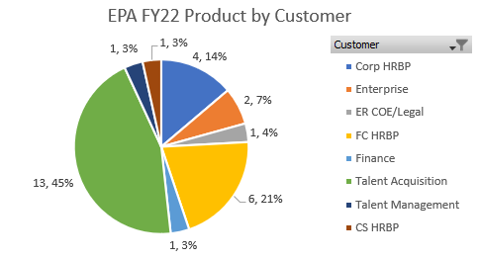
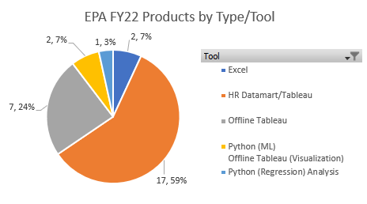
FY22 Results To Date
YTD the EPA team has accomplished the following results*
Business Intelligence and Analytics Products
18 of 29 (62%) products complete, remaining 11 (38%) in process as of P8
TA – 13 (45%)
FC HR – 6 (21%)
Corp HR – 4 (14%)
Enterprise – 2 (7%)
CS HR, Talent Management (DEI), Finance and ER – 1 each (3%)
Multiple ad hoc analysis and deep dives to support additional insights (by request)
Research and Data Science
3 projects underway
FC CAT Tracker (VOC analyzed for themes/actions) – POC complete
CS Attrition Seasonality Prediction – Phase 1 complete
Attrition Casual Inferences – Phase 1 in process
Data Strategy
Delivered technical Snowflake updates, first phase of product layer (28 data products), manager hierarchy history, roster history, and Integration Health Dashboard; Phase 1 data definitions in process
Innovation Projects (in process)
HR API POC
Advanced Graphical Manager Hierarchy Analysis PoC
HR Analytics Portal
*Full inventory of EPA products contained on slides 29 - 32

Slide 23
EPA Wins and Opportunities
Wins
Areas of Opportunity
Clear Customer Alignment
More efficient and clear alignment to customer groups
External and internal engagement / client management
Deep Business Immersion
Provides the ability to keep pace with business and quickly address needs because of close client connection
Reset of Data Foundation
Reliability and standardization of data being provided
Reset HR Data Mart foundational (in process)
Product Creation Efficiency
Able to create products quickly due to connection to business needs and organizational alignment
Created efficiencies and reliability in MBR process
Ad Hoc Customer Requests
Delivered incremental products and enhancements outside the defined Op1s
Supported numerous ad hoc requests for deep dive and follow up analysis to support decision making and strategic direction
Team Culture
Collaborative, engaged culture that solves problems together
Evolve How We Leverage the EPA Team
FY22 focus was to fix being "data dry" and primary focused on developing reporting products; in the future, EPA should be engaged to generate insights and help tell the story along with the data
Focus on Product Sustainability and Scalability
31% of the EPA products have been created in ad-hoc ‘scrappy’ solutions (I.e., excel), and time will be required to convert these into long-term, scalable solutions
Product scalability will require EPA to build for the Enterprise first, and localize as needed; vs developed for individual customer/team need, which requires a paradigm shift
Continue to scale data science foundation (I.e., data accessibility and platforms)
Increase Self-Service
Drive to self-service and utilization of products to answer ad-hoc and operational requests through 1) optimizing user experience, 2) providing data accessibility, and 3) supporting data fluency and analytics competency.
Deliver products that can scale with the evolution of business without disrupting capabilities, accessibility, or user experience.
Advance Client Adoption and Product Advocacy
Support client adoption and drive advocacy of products (I.e., TA Exempt), especially we shift to Enterprise-wide tools vs business specific needs
Formalize Closed Feedback Loop
Implement closed loop feedback mechanism to monitor customer sentiment on EPA products and service.
Ensure Team is Sufficiently Resourced
Increase dedicated DEI/L&D/Comp insights and analysis resources (FY23)
Determine when we can support other HR teams not in scope today (HRSS)
Appropriately resource projects for the anticipated increase in data science demand
Supplement HRIT resources appropriately to support data infrastructure

Slide 24
APPENDIX

Slide 25
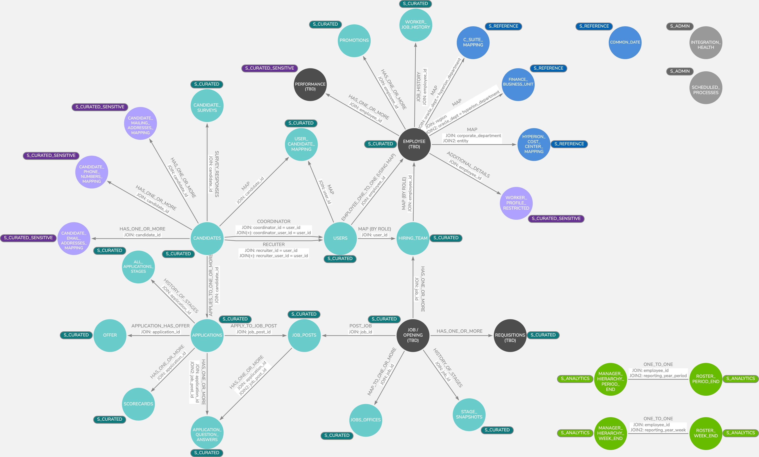
Product: Business Layers of Data Mart
Conceptual Model of Business Layers
Objective
Provides the design and blueprint for the Data Mart business layers (curated and analytics).
Audience
HRIT (HR Data Mart Team), EPA BI Developers (and other HR Analysts)
Business Value
Provides a blueprint for the HR Data Mart team to develop toward. Also provides documentation for end users to know how the tables are related and how to join them together.
Key
Features
Shows Schema (by color), Table or View Names by Node, and Join Relationships
What’s Next
As we continue to build out the Data Mart, we will continue to design and update the Conceptual Data Model for new data sources and domains.
Link Available Here

Slide 26
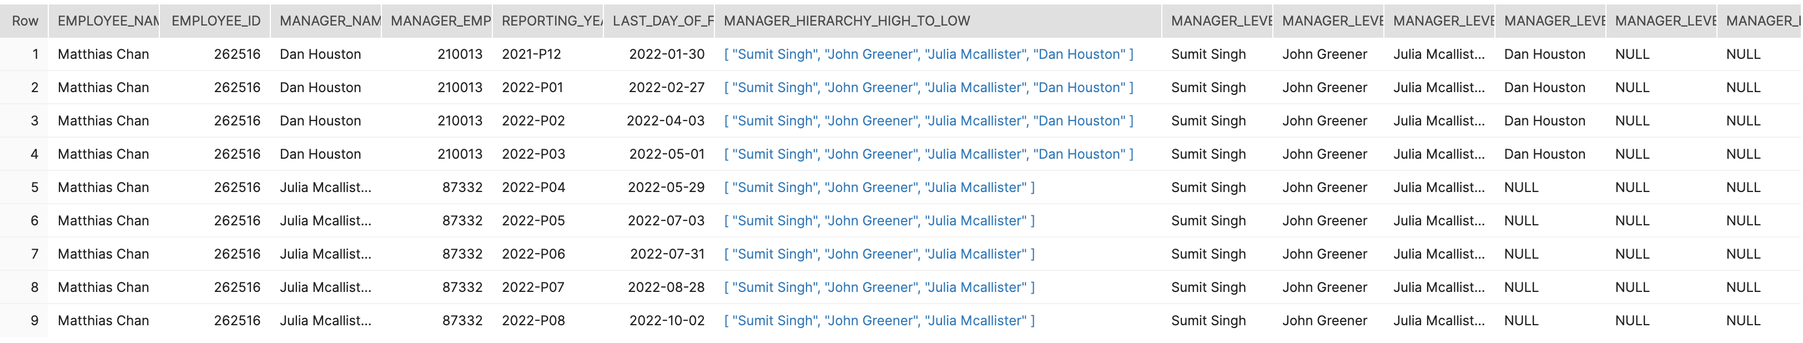
Product: Analytics Layers of Data Mart
Manager Hierarchy by Period / Week
Objective
Provides the Manager Hierarchy of each employee at any given period or week.
Audience
EPA BI Developers (and other HR Analysts using Data Mart)
Business Value
Creates the Employee to Manager Hierarchy up to 10 Levels Deep for each Employee at any given Period or Week for analytics and reporting.
Key
Features
Full hierarchy in array, as well as parsed into individual fields.
What’s Next
Utilize the views in the Tableau Dashboards

Slide 27
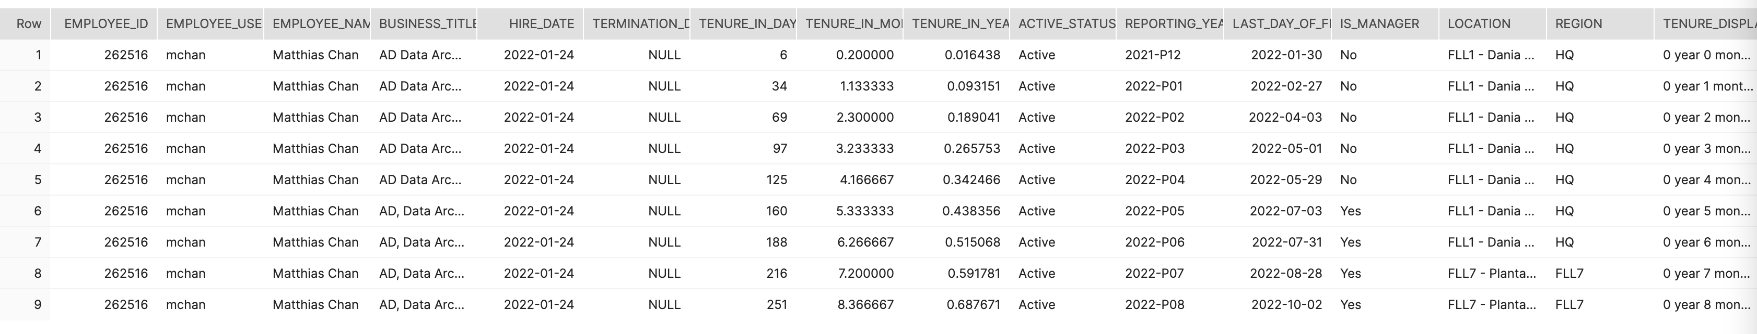
Product: Analytics Layers of Data Mart
Roster by Period / Week
Objective
Provides all non-terminated employees, and any terminated employees within a Period or Week.
Audience
EPA BI Developers (and other HR Analysts using Data Mart)
Business Value
Gives the roster at the end of each period or week in history. Can use this view to drive all our metrics (i.e. Attrition, Headcount, Dwell Time, etc.)
Key
Features
End of Period or Week Employee Attributes. Additional calculated fields, such as Tenure.
What’s Next
Utilize the views in the Tableau Dashboards

Slide 28
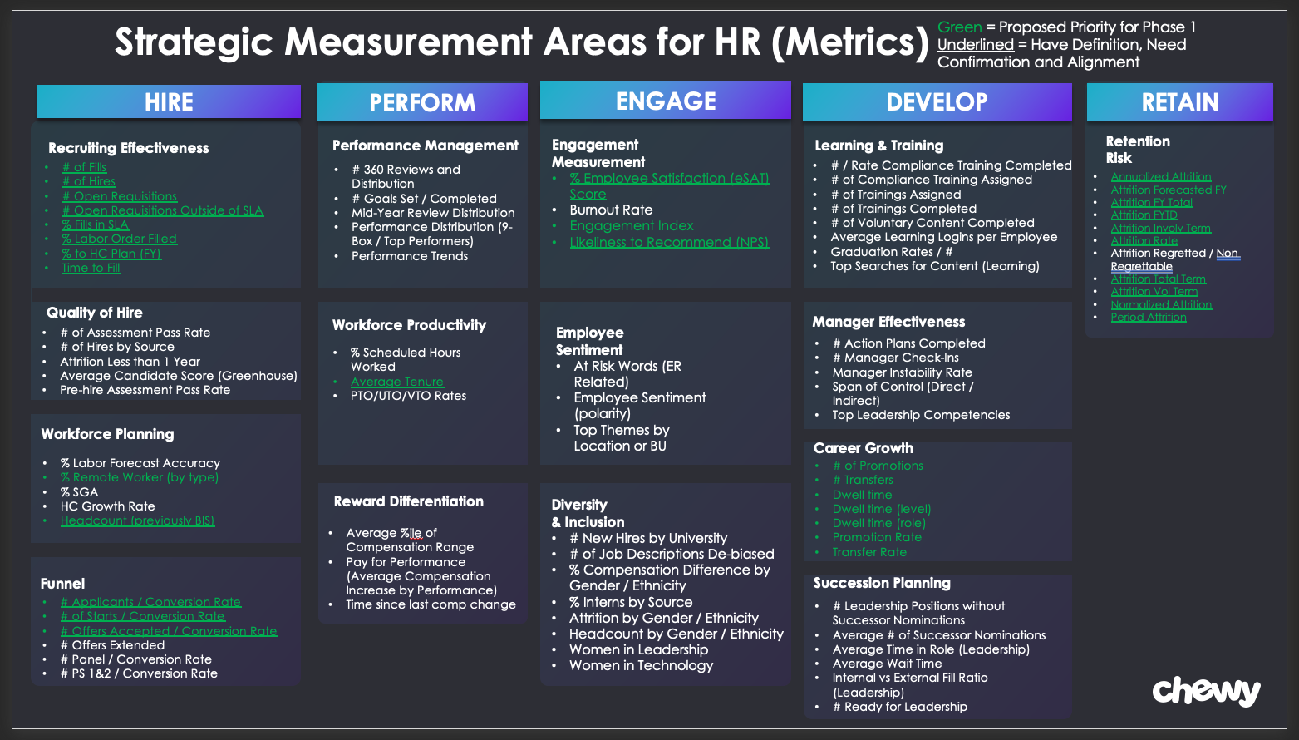

Slide 29
EPA Product Inventory
EPA Product | Customer | Business Value | Tool | Status
People Analytics Workforce Summary (PAWS) Dashboard | Corp HRBP | Expanding the current Corporate HRBP dashboard to include FC / CS HRBP teams. | HR Datamart/Tableau | In-Flight
Monthly C-Suite Packets (Corp) |  | Monthly impactful break-outs of attrition trend data in a standardized, enterprise-wide format for each C-suite leader. | Offline Tableau | Complete
Attrition Ad Hoc Analysis Tool |  | Internal tool for EPA team which provides flexibility to answer non-standard attrition-related questions quickly | Offline Tableau | Complete
HR MBR Page 0 Automation Tool |  | Automate monthly headcount / attrition updates that were previously manually consolidated for the HR MBR; allows for efficient data and insight generation. | Offline Tableau | In-Flight (V1 – P9, V2 - TBC)
FC Site Summary Dashboard | FC HRBP | Provides self-service for current weekly views and historical trends. Standard WBR reporting for FC (including Rx), providing historical attrition, attendance and headcount trends by FC location. Published weekly and running parallel with excel reporting; focus on driving adoption with FC users (at 30%) and establish adoption targets long term. | HR Datamart/Tableau | Complete
EVP Dashboard |  | Measurement for the 5 EVP pillars within the FC. Including Leading and Lagging indicators measuring employee Safety/ Wellbeing, Recognition, Belonging, Growth and Voice. Site level summary distribution (P9). | Excel | Complete
Retention WBR/ MBR Page 0 Report |  | Provide one source of truth for all retention metrics supporting business reviews and deep dive options, used in the weekly retention WBR (Project Cobra). | Excel | Complete
Monthly C Suite Packet - Operations FC, SC, Log, Facilities |  | Provide COO, VP and Sr Directors visibility to detailed attrition cuts for all orgs/leaders/cc under an all Operations view / Scott Anderson Org. | Offline Tableau | Complete
Talent Management Dashboard | Talent Management | Provides snapshot of talent related metrics, including dwell time, performance, and attrition trends; currently in use by FC in an excel format, but enterprise-wide version is being built into a dashboard. | HR Datamart/Tableau | Complete (Excel) In-Flight (HRD/Tab)
Monthly C-Suite Packets (CS) | CS HRBP | Provides impactful break-outs of attrition trend data in a standardized, repeatable framework with slight additions specific to the CS business | Offline Tableau | Complete
DEI Dashboard | DEI / Talent / C-Suite | Enables visibility to workforce representation and hiring / promotion / attrition trends from a DEI perspective. | HR Datamart/Tableau | Complete
OpenBark Dashboard | Ethics and Compliance | Enable informed decision making with legal and regulatory risks, corporate culture, and overall health of the compliance program by providing access to investigation details and trends. | Offline Tableau | In-Flight (P9)
Notes:
How to condense the Business Value? – how many people use this? What is the biggest value? Do we quant Do we indicate those that are product demos?
This goes to the appendix?

Slide 30
EPA Product Inventory
EPA Product | Customer | Business Value | Tool | Status
Internal Mobility Dashboard | Talent Acquisition | Provide TA Internal Mobility team with reporting and insights to monitor performance of candidate movement through the funnel, SLA times, and hiring rates for internal candidates, and benchmark performance against internal candidates being processed outside the IM team. | HR Datamart/Tableau | Complete
Candidate SLA Monitoring Tool | Talent Acquisition | SLA monitoring tool to identify any candidates that have not moved through the funnel in a timely manner and may be at risk of breaching SLA (enterprise in scope/ Ex and NEx). | HR Datamart/Tableau | Complete
Aging Posts Dashboard |  | Monitor the aging of requisition and job postings by source so that sourcing team has better visibility on when to refresh to reduce diminishing returns (enterprise in scope/ Ex and NEx). | HR Datamart/Tableau | Complete
Quality of Candidate Dashboard | Talent Acquisition | Measure the performance by source based on the outcomes of the candidates that pass through them. Pilot is in testing for CS HV QoC. Each use case will need to be reviewed/developed independently for specific variables. | HR Datamart/Tableau | In-Flight CS HV (P9) QoC (Q2 FY23)
Rejection Reasons Dashboard | Talent Acquisition | Provides granular detail as to why a candidate was rejected by Chewy or why a candidate rejected Chewy. Dimensionality to view trends by various factors (enterprise in scope/ Ex and NEx). | HR Datamart/Tableau | In-Flight (P9)
Recruiter Productivity Dashboard | Talent Acquisition | Monitor the volume, outcomes, and overall effectiveness of recruiter. Measurements for SLA, hire rates, and time to fill (enterprise in scope/ Ex and NEx). | HR Datamart/Tableau | In-Flight (P10)
Interviewer Volumes Dashboard | Talent Acquisition | Monitor the volume, outcomes, and overall effectiveness of interviewer. This is to measure consistency and reliability of selected interviewers to ensure we are putting the right TMs in front of candidates (enterprise in scope/ Ex and NEx). | HR Datamart/Tableau | In-Flight (P10)
CS High Volume Dashboard V2 | TA High Volume | Automation of manual, operational reporting providing key CS high volume staffing metrics and trend analyses to provide better consistency, accuracy, reliability, and efficiency of these reports. | HR Datamart/Tableau | Complete
Peak Wage Incentive Analysis | TA High Volume | Analysis on correlation of wage incentives, by location, during the peak season to help determine if there was any statistical significance between the incentive and the outcome of applications and hires. | Excel/Offline Tableau | Complete
FC High Volume Dashboard V2 | TA High Volume | Automation of manual, operational reporting providing key metrics and trend analyses to provide better consistency, accuracy, reliability, and efficiency of these reports. | HR Datamart/Tableau | In-Flight (P12)
TA Exempt Dashboard | TA Exempt | Automation of manual, operational reporting providing key metrics and trend analyses to provide better consistency, accuracy, reliability, and efficiency of these reports. | HR Datamart/Tableau | Complete
Viking Dashboard | TA Exempt | Legacy Dashboards: Executive view providing key information from three source systems (Workday, Greenhouse, and Hyperion) to give a holistic view into headcount trends and hiring performance. | HR Datamart/Tableau | Complete FY21
Eagle Eye Dashboard | TA Exempt |  | HR Datamart/Tableau | Complete FY21
Brass Tacks Dashboard | Finance | Legacy Dashboard: Detailed summaries for finance headcount reporting. | HR Datamart/Tableau | Complete FY21

Slide 31
EPA Product Inventory
EPA Product | Customer | Business Value | Tool | Status
Fulfillment CAT Tracker Analysis | FC (Listening Mechanisms NLP) | Across the FC, employee listening mechanisms lack insights to create actionable changes. Common themes and sentiment across VOC channels require leaders to manually read and interpret the comments to summarize themes. This product will use Natural Language Processing (NLP) and Tableau visualization help leaders save time identifying themes and identify recommended actions. | Python (ML) Offline Tableau (Visualization) | POC Completed: Topic monitoring and Sentiment Analysis- Complete P7 In-Flight – Phase 1 base model ML to derive action plans P8
Attrition Seasonality Predictions | Enterprise (Fulfillment + Customer Service + Corp) | Chewy Enterprise wants a better forecasting model to predict long-term attrition rate (up to 6 months) across FC and CS. Goal is to develop a model for each of the sectors to provide insights into expected attrition rate for the next 3-6 months. Insights will provide business leaders better expectation for the future attrition. This model will develop attrition forecasting model based off seasonality / historical data for CSNE and FCNE. | Python (ML) Offline Tableau (Visualization) | Complete - Phase 1 P8 In-Flight – Phase 2 (increase confidence) P9
Causal Inferences - Attrition | Enterprise (Fulfillment + Customer Service + Corp) | A holistic analysis on true drivers of nonexempt employee attrition. We want to understand which variable has the largest effect to attrition and which one has less effect, so we can prioritize resource effort. (Example, tenure, attendance, shift, dept etc.) | Python (Regression) Analysis | In-Flight: Q4

Slide 32
EPA Product Inventory
EPA Product | Business Value | Tool | Status
Data Driven Alerts | Gives us the ability to trigger alerts based off data to alert for data quality issues, trends in the data, errors in process, etc. This allows Chewy HR to proactively action on data and insights instead of having to react to issues when the business identifies them. | HR Data Mart | Complete
Integration Health Dashboard | Health of the all Integrations managed by the Workday Integrations team (HRIT), which allows us to identify patterns in error rates, any issues in daily data integrations, and proactive monitor of HRIT KPIs around Data Integrations. | Tableau | Complete
HR Data Mart Governance and Security Features | Features to protect employee privacy and govern access. The HR Data Mart now has capabilities to do anonymization of data, as well as row and column level permissions to restrict access to the data at the raw detail level, without impacting the aggregate metrics that are derived for reporting like MBR. | HR Data Mart | Complete
Business Layers of the Data Mart (Curated, Analytics, Metrics) | Allows business users (end user through Tableau, or BI Developers through Snowflake) to easily access the data with pre-joined, harmonized datasets without having to duplicate logic across each individual business case, analysis and Tableau Dashboard | HR Data Mart | Phase 1 Complete Continuous
Conceptual Data Model | Gives the conceptual model for how the HR data is pulled together, how to join datasets together, and how to use the HR Data Mart. | Arrows Hackolade (TBD) | Continuous
HR API PoC | Builds standard, re-usable data via an API that allows systems (either Operational or Analytic) without having to hard code source information. Allows the replacement of data sources in the back end, and gives us consistency in data transmission through one central place. Adoption of the API would give developers an industry standard way to access the data in the HR Data Mart. Domains added to the HR API would include Employee / Contractor, Organizational Reference Data, Metrics and Analytics, etc. | Open API / Python | In-Flight (P10)
Advanced Graphical Manager Hierarchy Analysis PoC | Allows deeper manager hierarchy analysis outside of direct manager relationships. Will give business better insight and analysis on multi-length chains of Manager Hierarchies (I.e. Show me all people impacted by the attrition of a specific manager). Also allows analysis and insights into clusters of employees and organizational design | Graph DB (neo4j / AWS Neptune) | In-Flight (P12)
Business Capabilities / Enterprise Architecture / Data Mapping | Allows Chewy HR to think holistically about our systems, process and data, and for each business capability, identify the point of contacts / owners, KPIs and what data would be associated with them for ingestion into the HR Data Mart | Excel | In-Flight (P6 FY23)
HR Analytics Portal | One stop shop for all insights, analytics and data questions. This portal will provide access directly to the metrics and data (with full governance and access provisioning), and embed or link to the right Tableau Dashboards. This portal will be designed with Customer Experience as the primary goal, and reduce the complexity and time to value for getting answers and insights using data. | Homegrown (TBD) | Not Started

